Slide 1
Brain Tumor Detection
Report By,
T. VARUN (16WJ1A05V2)
Under the Guidance,
V. Devasekhar (HOD-CSE2)

Slide 2
Abstract
A human brain is centre of the nervous system; it is a collection of white mass of cells. A tumor of brain is collection of uncontrolled increasing of these cells abnormally found in different part of the brain namely Glial cells, neurons, lymphatic tissues, blood vessels, pituitary glands and other part of brain which lead to the cancer. Cancer of Brain is of two types. Benign which is not cancerous no danger at all, other one is Malignant which is cancerous tumor; it grows abnormally by multiplying the cells rapidly, which leads to the death of the person if not detected. Manually it is not so easily possible to detect and identify the tumor. Programming division method by MRI is way to detect and identify the tumor. In order to give precise output a strong segmentation method is needed.

Slide 3
Abstract
Brain tumor identification is really challenging task in early stages of life. But now it became advanced with various machine learning and deep learning algorithms. Now a day’s issue of brain tumor automatic identification is of great interest. In Order to detect the brain tumor of a patient we consider the data of patients like MRI images of a patient’s brain. Here our problem is to identify whether tumor is present in patient’s brain or not. It is very important to detect the tumors at starting level for a healthy life of a patient. There are many literatures on detecting these kinds of brain tumors and improving the detection accuracies.

Slide 4
Abstract
The segmentation, detection, and extraction of infected tumor area from magnetic resonance (MR) images are a primary concern but a tedious and time taking task performed by radiologists or clinical experts, and their accuracy depends on their experience only. So, the use of computer aided technology becomes very necessary to overcome these limitations.
We estimate the brain tumor severity using Convolutional Neural Network algorithm which gives us accurate results.

Slide 5
Existing Method
The existing model uses the MRI images and classifies the images whether the Tumor is present in that image or not.
It does not take other inputs or cannot suggest what are the steps or precaution to be taken
The drawback is that the model will not use any kind of filters to improve the accuracy.

Slide 6
Proposed Method
The proposed model will use Gaussian filters, Canny filters, erode, dilate, and bitwise filters that will help the Convolutional Neural Network (CNN) to achieve the greater accuracy.
This model also include methods which get the input from the user like headache and can classify the given input according to the brain tumor symptoms feed.
The proposed CNN model achieved an accuracy of 99.7% by using the above methods.

Slide 7
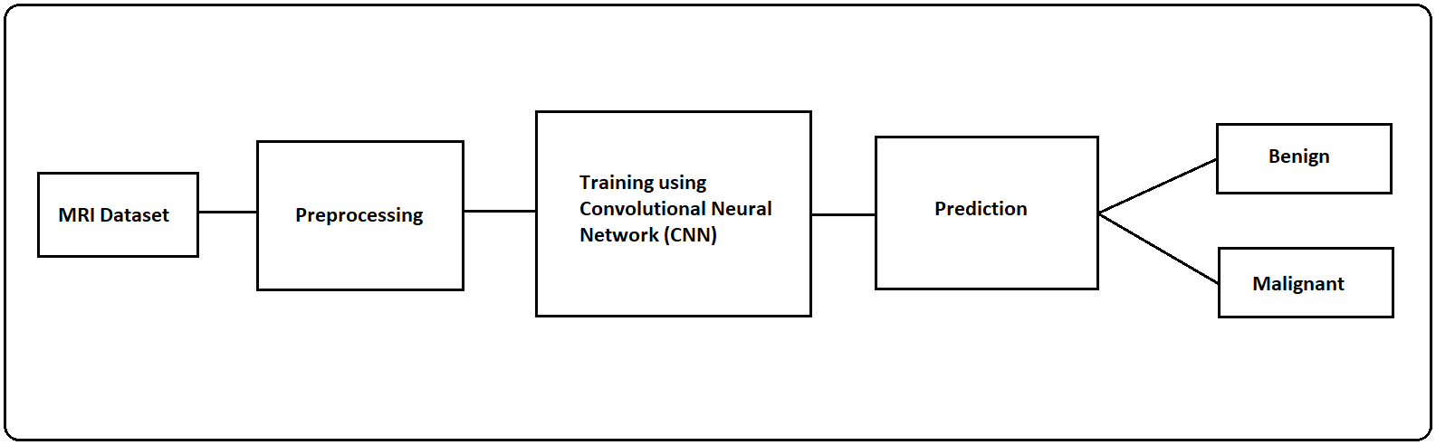
Architecture

Slide 8
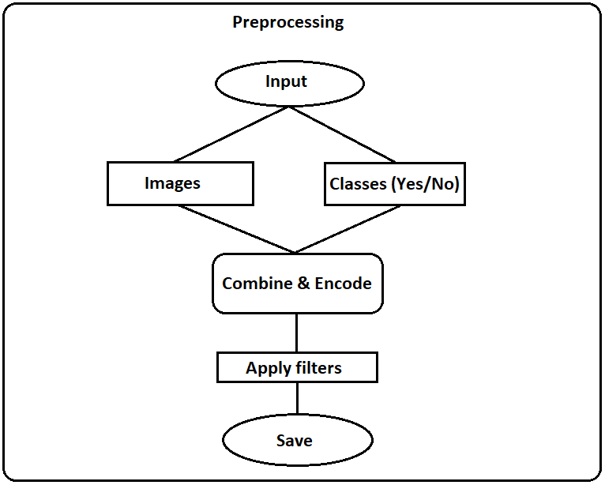
Pre-processing Data

Slide 9
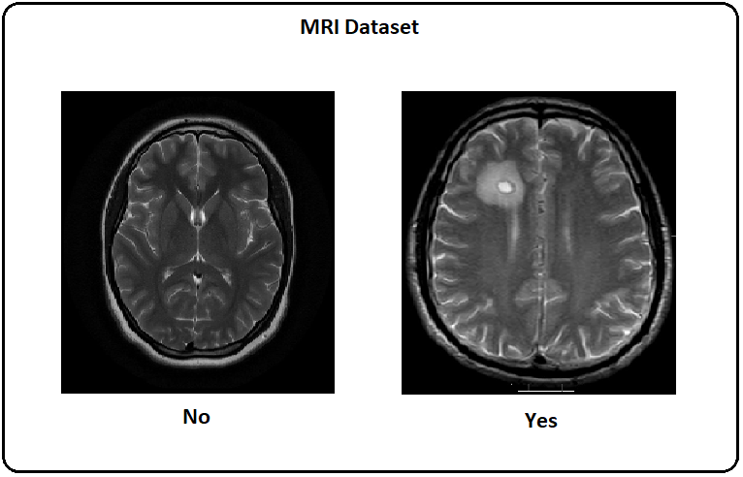
Dataset Model

Slide 10
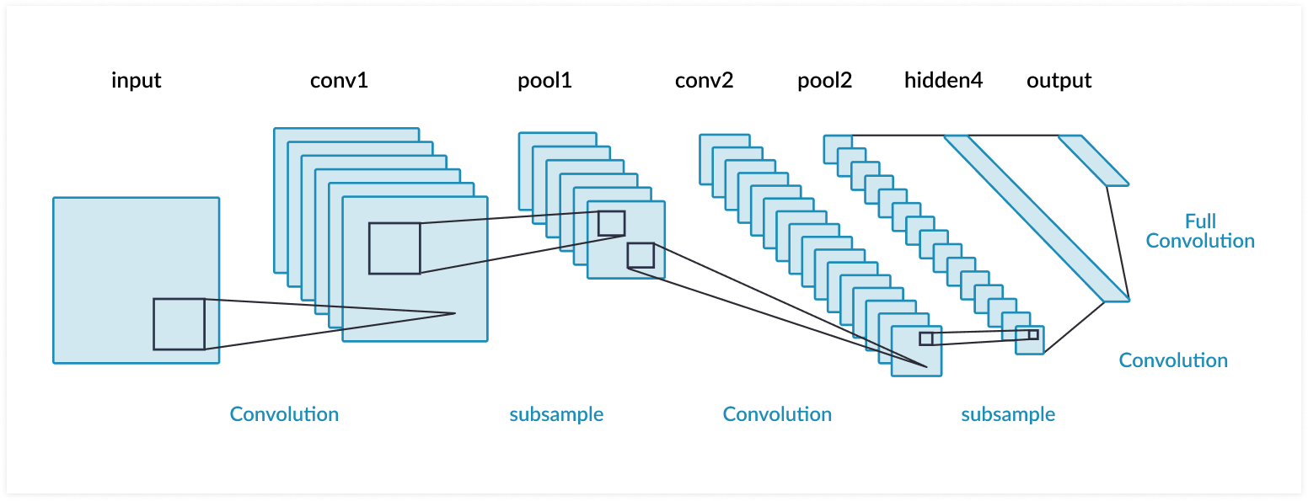
Convolutional Neural Network Model

Slide 11
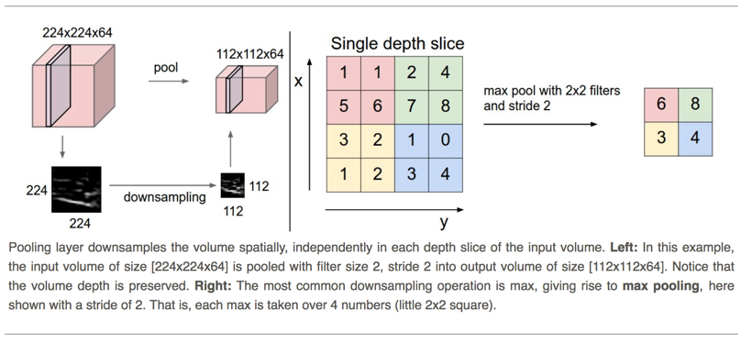
Pooling

Slide 12
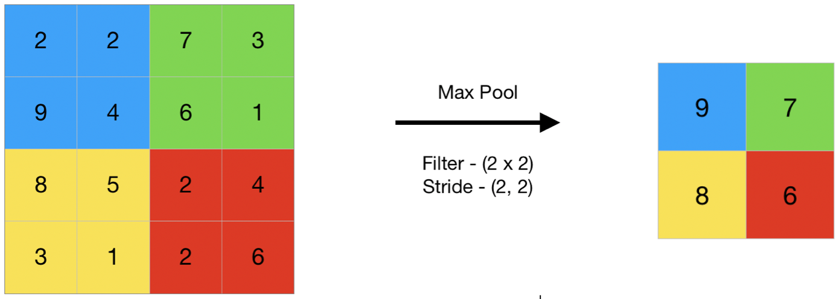
Pooling

Slide 13
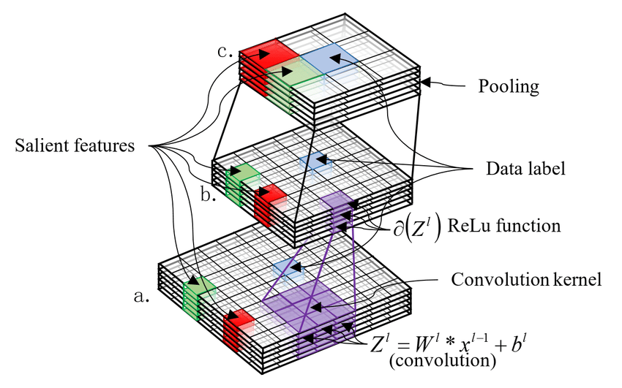
Feature Extraction

Slide 14
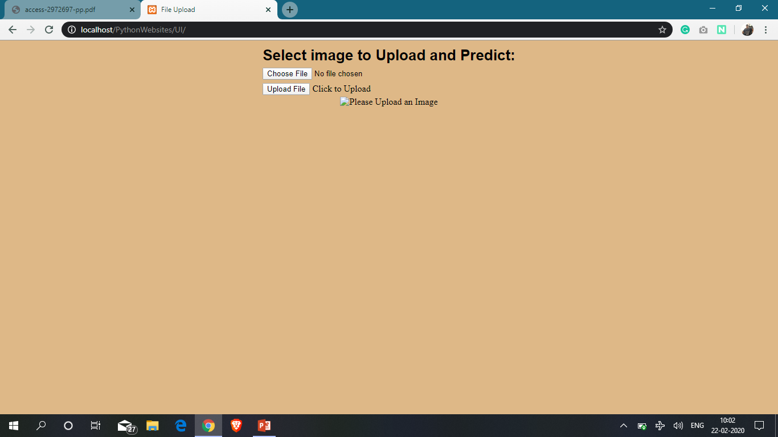
Screenshot - 1

Slide 15
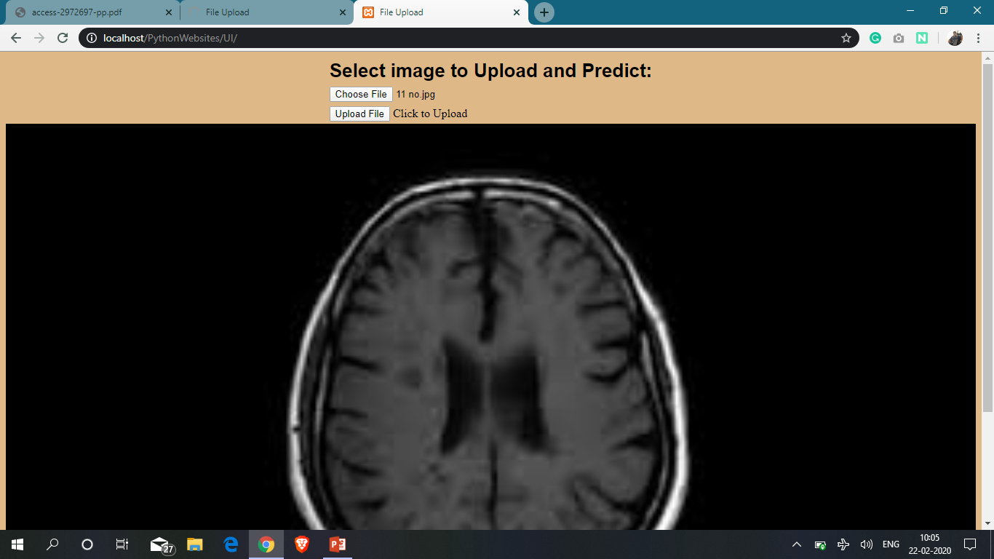
Screenshot - 2

Slide 16

Screenshot - 3

Slide 17
Conclusion
As the other input from the user are considered along with the MRI scan data the predictions can be accurate in most of the cases.
The results of the model can be seen in the following slide where the graph of achieved accuracy and loss is displayed.
We can see that the accuracy gradually increases from 60% and achieve 99.7%, and the loss decreases from 60% to almost of 0%.

Slide 18
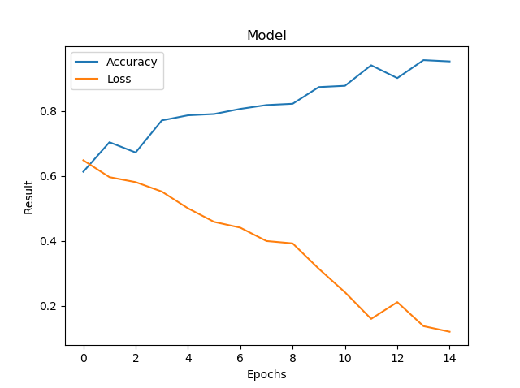
Results

Slide 19
Future Enhancements
The proposed model can be additionally added with the real time patients data and the predictions can be more accuracy in all the cases which will help the patients to save their money by avoiding the initial visit to the hospital. Once the tumor is conformed by the model they can visit the hospital and can get their treatment.
The model can even be trained on the other kind of tumor data where it can excel the predictions.

